Slide 1
22CS2403 Database Management System Mini Project Airport Management System
ENG22CS0321-Hrushikesh Raghavendra
ENG22CS0304-Gagan Nagarjuna
ENG22CS0292-Dhruv Ravi

Slide 2
Introduction
Developed an advanced Airport Management System to optimize airport operations.
Utilized Django framework and MySQL for efficient database management.
Streamlined handling of flight schedules, arrivals, departures, and passenger data.
Core functionalities include adding, updating, and deleting flight and passenger records.
User interface designed with Bootstrap for responsiveness and ease of use.
Integrated security measures to safeguard database access and ensure data integrity.
Reduces manual workload and minimizes errors with real-time updates.

Slide 3
Problem Statement
Develop a web application for managing airport operations. The system should allow users to view and manage flight schedules, arrivals, departures, passengers, and gates. Features include adding, updating, and deleting arrivals, departures, and passengers. The application must provide a user-friendly interface, real-time data updates, and ensure data integrity and security.

Slide 4
System Architecture
The Airport Management System follows a Model-View-Controller (MVC) architecture:
Models: Define database structure using Django's models.
Views: Handle user requests and render templates.
Controllers: Map URLs to views, facilitating user interactions.
MySQL: Stores application data securely.
External Dependencies: Utilize Bootstrap for frontend design and MySQL Connector for database connectivity.
This architecture ensures a well-organized separation of concerns, simplifying development, maintenance, and scalability while enhancing security and user experience.

Slide 5
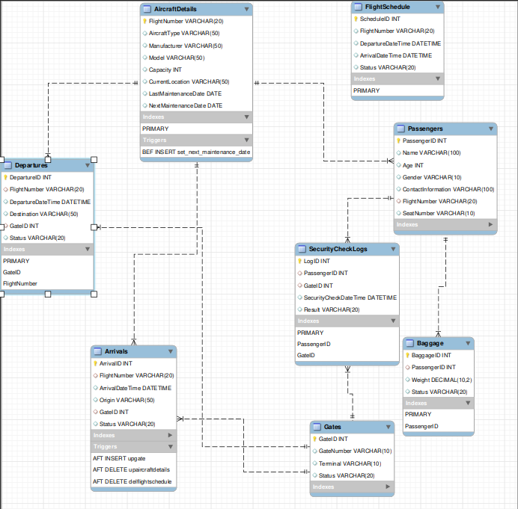
Database Design

Slide 6
Implementation
Technologies and Tools Used:
Django Framework: Enables rapid web app development.
MySQL Database: Manages application data efficiently.
Bootstrap: Provides responsive design.
HTML, CSS, JavaScript: Frontend development.
Python: Backend logic.
MySQL Connector: Connects to MySQL database.
Visual Studio Code: Development IDE.
Key Features Implemented:
Flight Management: CRUD operations.
Passenger Management: CRUD operations.
Schedule Management: Real-time updates.
Arrival/Departure Tracking: Status updates.
Responsive UI: Bootstrap framework..
Error Handling: Robust error management.

Slide 7
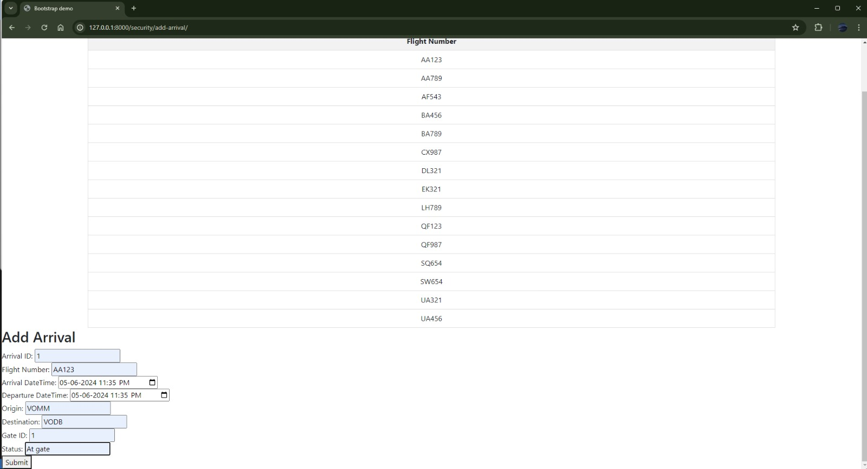
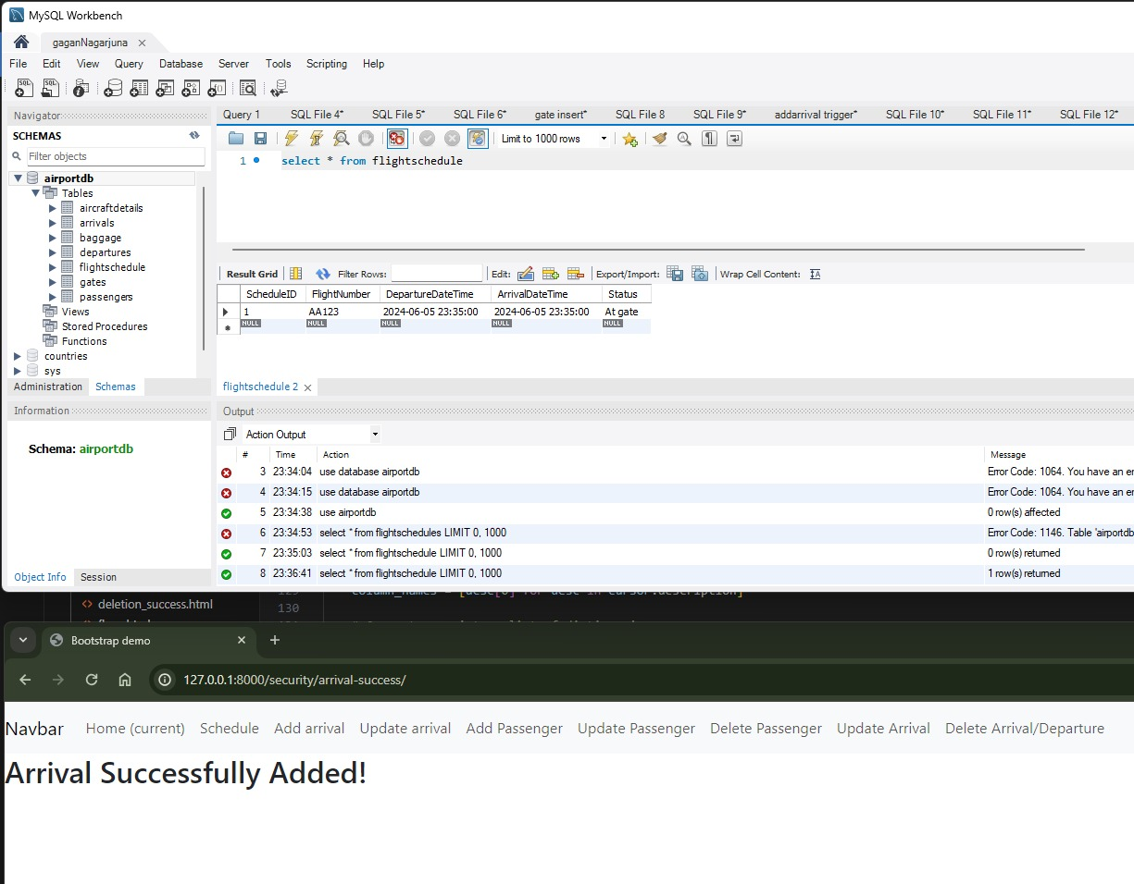
User Interface
Add arrival and display flightschedule

Slide 8
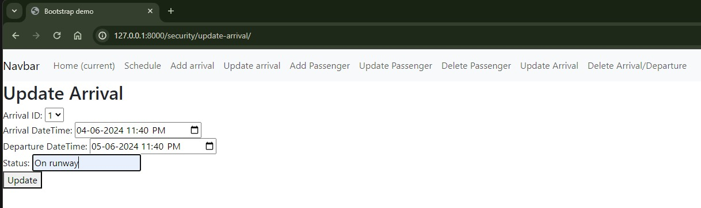
User Interface
Update arrival

Slide 9
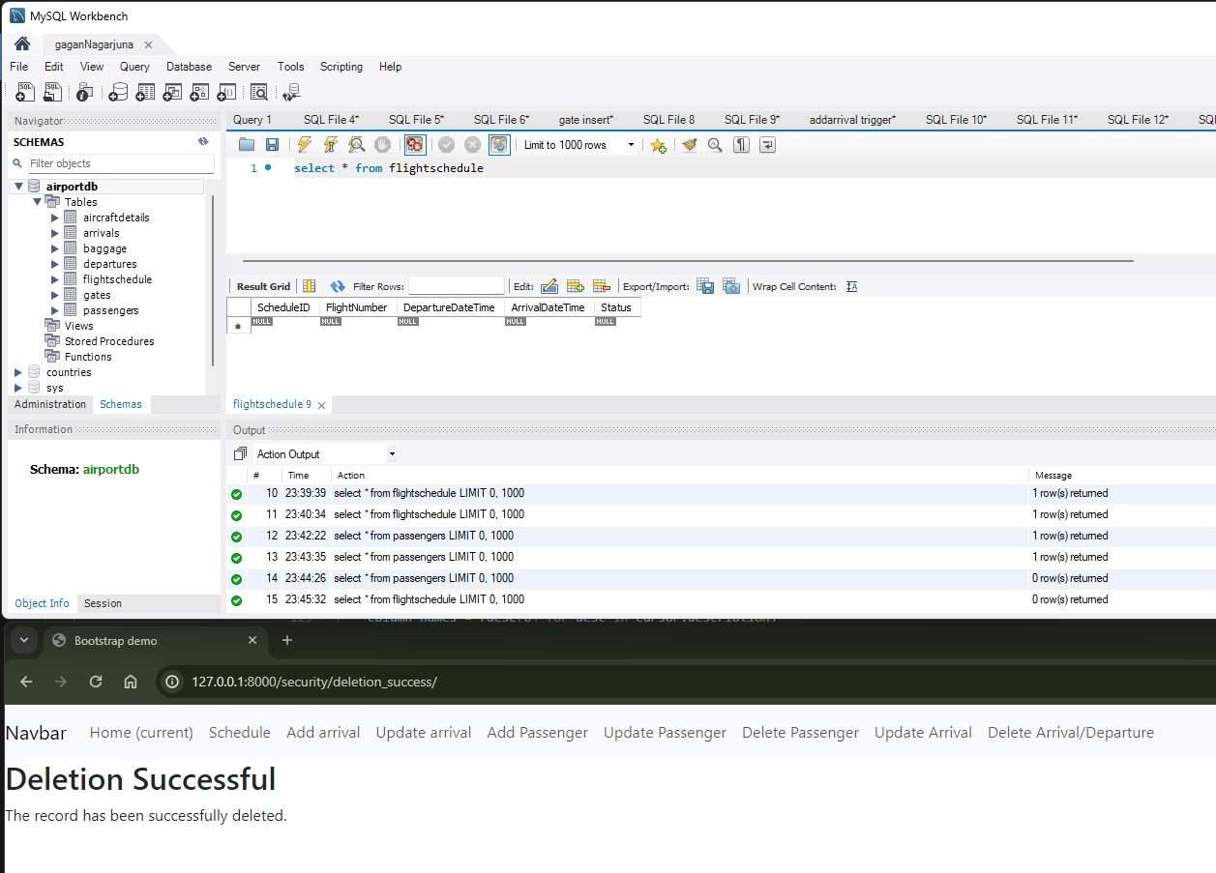
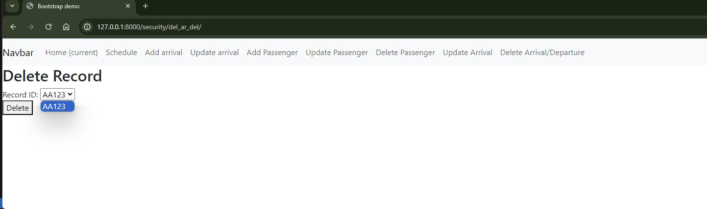
User Interface
Delete Flight

Slide 10
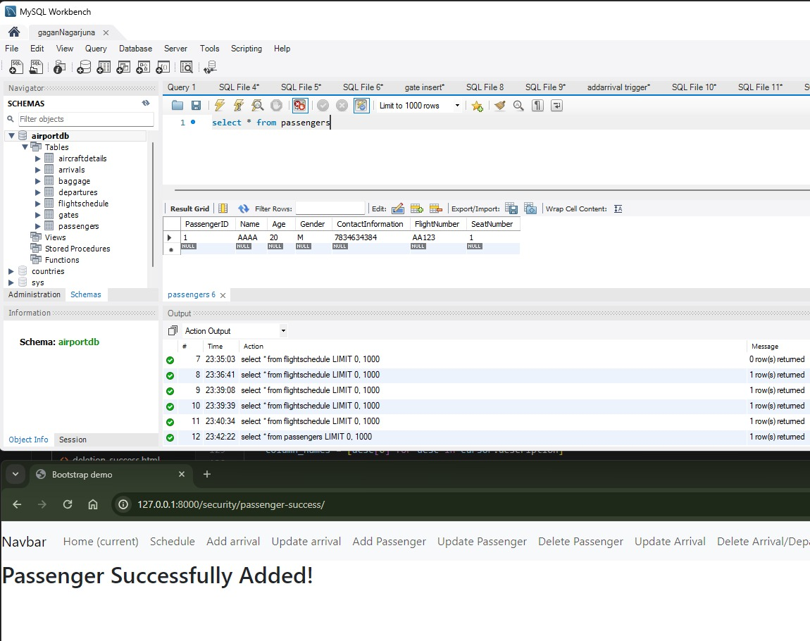
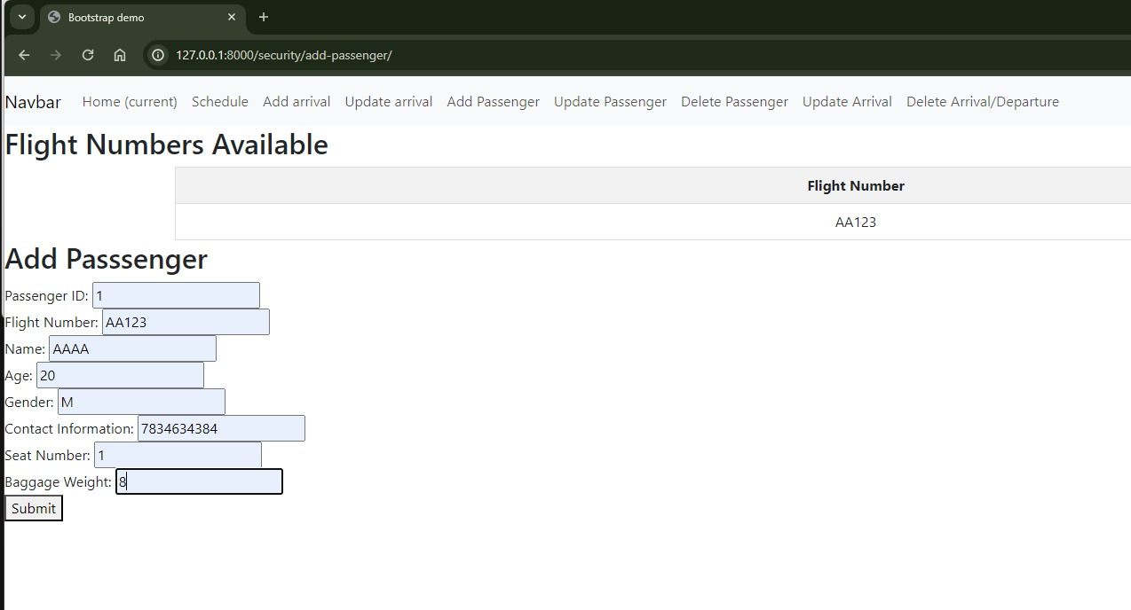
User Interface
Add passenger

Slide 11
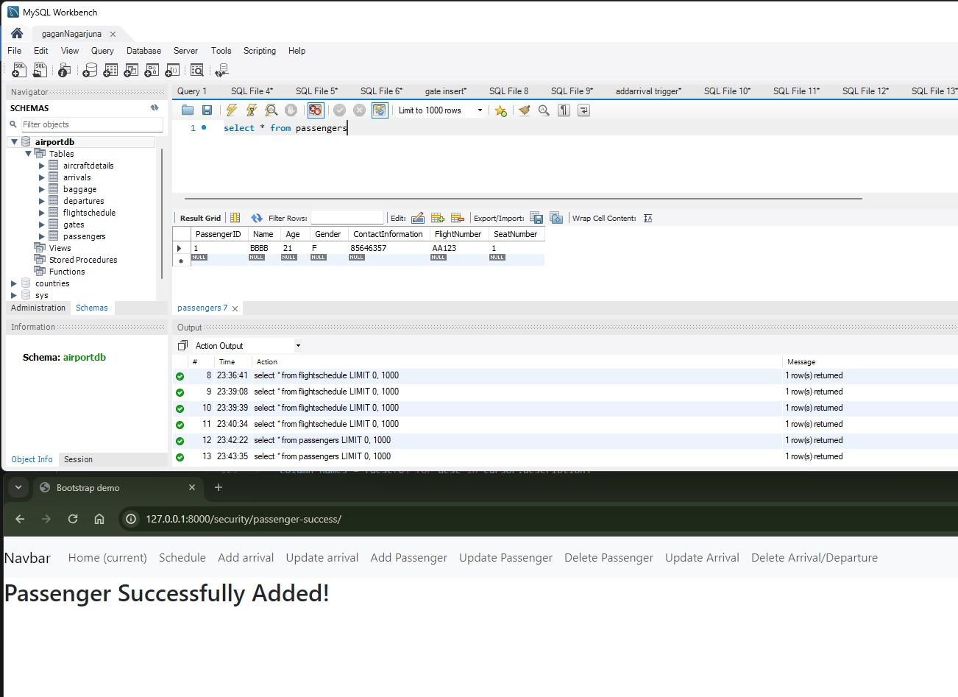
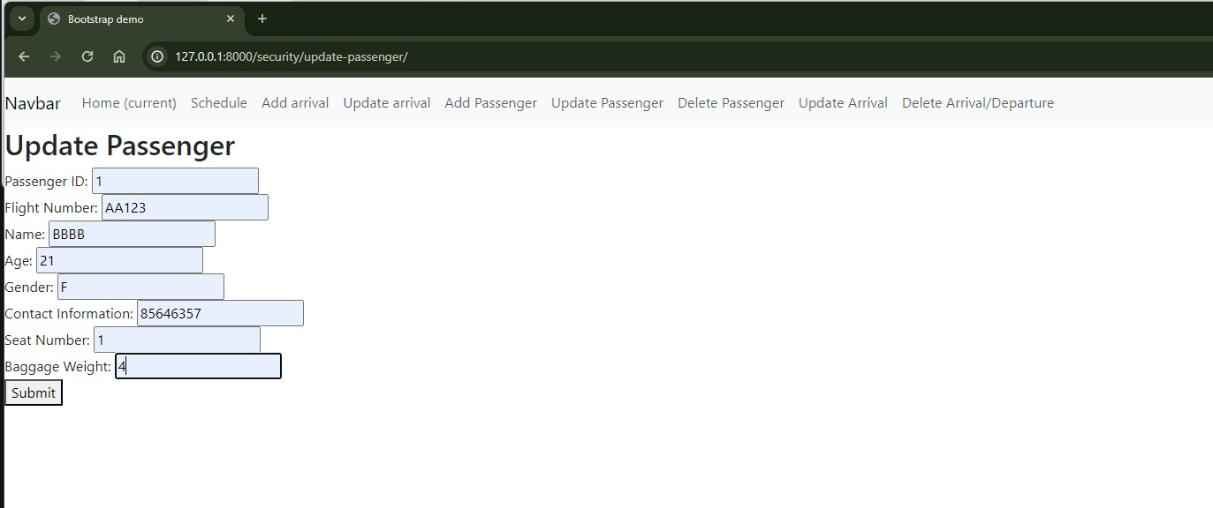
User Interface
Update passenger

Slide 12
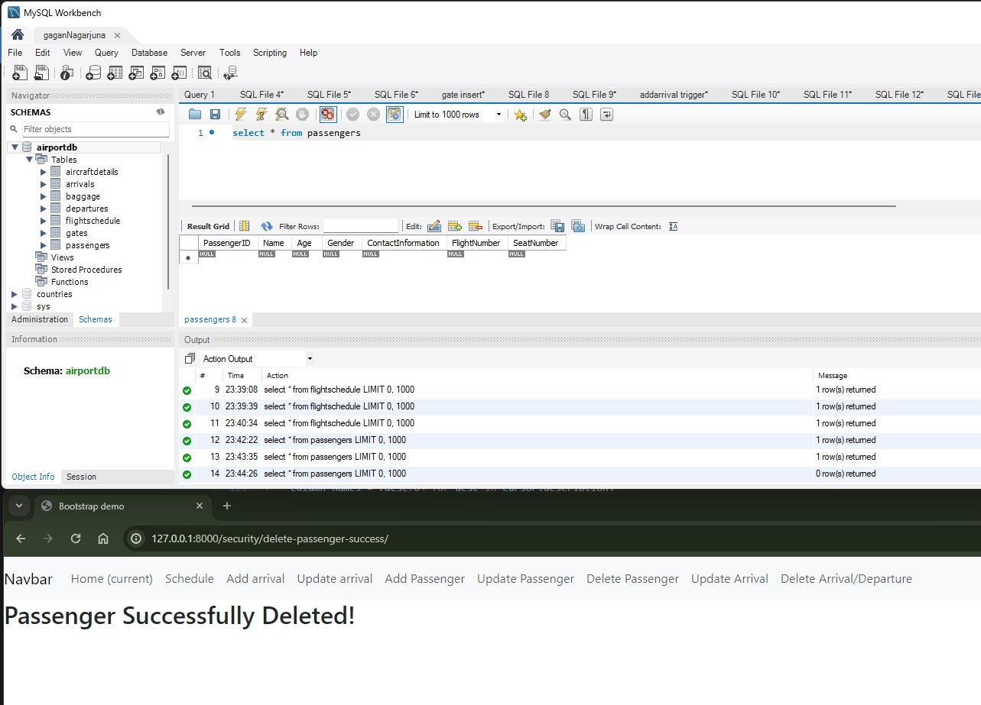
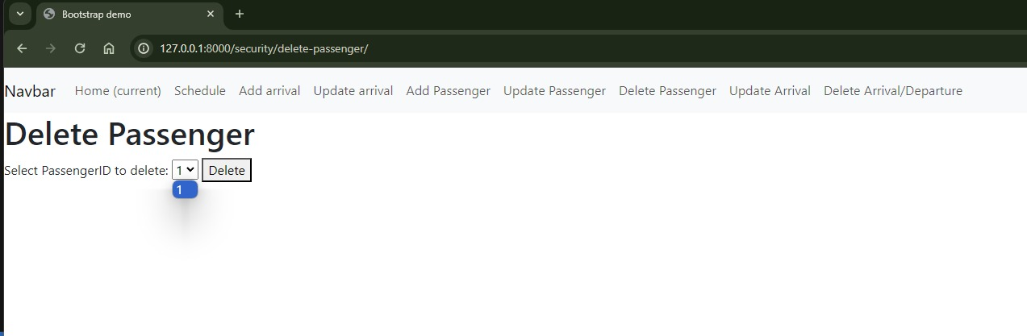
User Interface
Delete passenger

Slide 13


